Slide 2

What is Regression
Regression is one of the most important types of data analysis.
For example, you can observe several employees of some company and try to understand how their salaries depend on the features, such as experience, level of education, role, city they work in, and so on.
This is a regression problem where data related to each employee represent one observation. The presumption is that the experience, education, role, and city are the independent features, while the salary depends on them.
Generally, in regression analysis, you usually consider some phenomenon of interest and have a number of observations. Each observation has two or more features. Following the assumption that (at least) one of the features depends on the others, you try to establish a relation among them.
Some Terminology
The dependent features are called the dependent variables, outputs, or responses.
The independent features are called the independent variables, inputs, or predictors.
Regression problems usually have one continuous and unbounded dependent variable. The inputs, however, can be continuous, discrete, or even categorical data such as gender, nationality, brand, and so on.
It is a common practice to denote the outputs with 𝑦 and inputs with 𝑥. If there are two or more independent variables, they can be represented as the vector 𝐱 = (𝑥₁, …, 𝑥ᵣ), where 𝑟 is the number of inputs.

Slide 3
When do you need Regression ?
Typically, you need regression to answer whether and how some phenomenon influences the other or how several variables are related. For example, you can use it to determine if and to what extent the experience or gender impact salaries.
Regression is also useful when you want to forecast a response using a new set of predictors. For example, you could try to predict electricity consumption of a household for the next hour given the outdoor temperature, time of day, and number of residents in that household.
Regression is used in many different fields: economy, computer science, social sciences, and so on. Its importance rises every day with the availability of large amounts of data and increased awareness of the practical value of data.

Slide 4
Linear Regression
Linear regression is probably one of the most important and widely used regression techniques. It’s among the simplest regression methods. One of its main advantages is the ease of interpreting results.
Problem Formulation
When implementing linear regression of some dependent variable 𝑦 on the set of independent variables 𝐱 = (𝑥₁, …, 𝑥ᵣ), where 𝑟 is the number of predictors, you assume a linear relationship between 𝑦 and 𝐱:
𝑦 = 𝛽₀ + 𝛽₁𝑥₁ + ⋯ + 𝛽ᵣ𝑥ᵣ + 𝜀.
This equation is the regression equation.
𝛽₀, 𝛽₁, …, 𝛽ᵣ are the regression coefficients, and 𝜀 is the random error.
Linear regression calculates the estimators of the regression coefficients or simply the predicted weights, denoted with 𝑏₀, 𝑏₁, …, 𝑏ᵣ.
They define the estimated regression function 𝑓(𝐱) = 𝑏₀ + 𝑏₁𝑥₁ + ⋯ + 𝑏ᵣ𝑥ᵣ.
This function should capture the dependencies between the inputs and output sufficiently well.
The estimated or predicted response, 𝑓(𝐱ᵢ), for each observation 𝑖 = 1, …, 𝑛, should be as close as possible to the corresponding actual response 𝑦ᵢ.
The differences 𝑦ᵢ - 𝑓(𝐱ᵢ) for all observations 𝑖 = 1, …, 𝑛, are called the residuals.
Regression is about determining the best predicted weights, that is the weights corresponding to the smallest residuals.
To get the best weights, you usually minimize the sum of squared residuals (SSR) for all observations 𝑖 = 1, …, 𝑛: SSR = Σᵢ(𝑦ᵢ - 𝑓(𝐱ᵢ))². This approach is called the method of ordinary least squares.

Slide 5
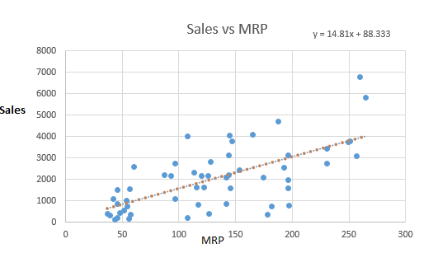
Simple Linear Regression
Simple or Univariate linear regression is the simplest case of linear regression with a single independent variable, 𝐱 = 𝑥.
The following figure illustrates simple linear regression:
The equation is Y = b0 + b1x. Take a look at the plot below between sales and MRP.
Surprisingly, we can see that sales of a product increases with increase in its MRP. There fore the dotted red line represents our regression line or the line of best fit.
Hold on…
There can be multiple lines that can be drawn to show the above points ?
But then one question that arises is how you would find out this line? – Next Slide

Slide 6
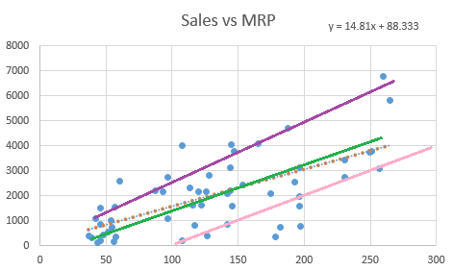
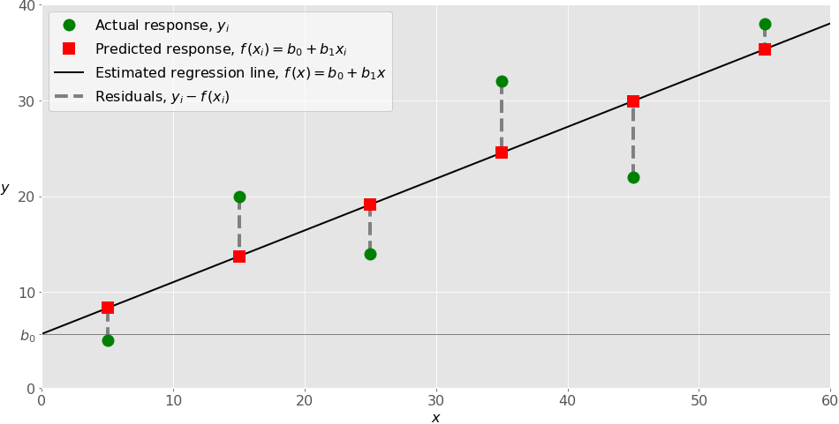

Line of Best Fit
As you can see below there can be so many lines which can be used to estimate Sales according to their MRP. So how would you choose the best fit line or the regression line?
The main purpose of the best fit line is that our predicted values should be closer to our actual or the observed values, because there is no point in predicting values which are far away from the real values. In other words, we tend to minimize the difference between the values predicted by us and the observed values, and which is actually termed as error. Graphical representation of error is as shown below. These errors are also called as residuals. The residuals are indicated by the vertical lines showing the difference between the predicted and actual value.
Okay, now we know that our main objective is to find out the error and minimize it. But before that, let’s think of how to deal with the first part, that is, to calculate the error.
We already know that error is the difference between the value predicted by us and the observed value. Let’s just consider three ways through which we can calculate error:
Sum of residuals (∑(Y – h(X))) – it might result in cancelling out of positive and negative errors.
Sum of the absolute value of residuals (∑|Y-h(X)|) – absolute value would prevent cancellation of errors
Sum of square of residuals ( ∑ (Y-h(X))2) – it’s the method mostly used in practice since here we penalize higher error value much more as compared to a smaller one,
so that there is a significant difference between making big errors and small errors, which makes it easy to differentiate and select the best fit line.
Therefore, sum of squares of these residuals is denoted by:
where, h(x) is the value predicted by us, h(x) =Θ1*x +Θ0 , y is the actual values and m is the number of rows in the training set.

Slide 7
Simple Linear Regression - Summary
When implementing simple linear regression, you typically start with a given set of input-output (𝑥-𝑦) pairs (green circles).
These pairs are your observations. For example,
1) the leftmost observation (green circle) has the input 𝑥 = 5 and the actual output (response) 𝑦 = 5.
2)The next one has 𝑥 = 15 and 𝑦 = 20, and so on.
The estimated regression function (black line) has the equation 𝑓(𝑥) = 𝑏₀ + 𝑏₁𝑥. Your goal is to calculate the optimal values of the predicted weights 𝑏₀ and 𝑏₁ that minimize SSR and determine the estimated regression function.
The value of 𝑏₀, also called the intercept, shows the point where the estimated regression line crosses the 𝑦 axis. It is the value of the estimated response 𝑓(𝑥) for 𝑥 = 0.
The value of 𝑏₁ determines the slope of the estimated regression line.
The predicted responses (red squares) are the points on the regression line that correspond to the input values. For example, for the input 𝑥 = 5, the predicted response is 𝑓(5) = 8.33 (represented with the leftmost red square).
The residuals (vertical dashed gray lines) can be calculated as 𝑦ᵢ - 𝑓(𝐱ᵢ) = 𝑦ᵢ - 𝑏₀ - 𝑏₁𝑥ᵢ for 𝑖 = 1, …, 𝑛. They are the distances between the green circles and red squares. When you implement linear regression, you are actually trying to minimize these distances and make the red squares as close to the predefined green circles as possible.
Simple or Univariate linear regression is the simplest case of linear regression with a single independent variable, 𝐱 = 𝑥.
The following figure illustrates simple linear regression:

Slide 8

Using Linear Regression for Prediction
So now let us take an e.g. where we use two features, MRP and the store establishment year to estimate sales
# importing basic libraries
import numpy as np
import pandas as pd
from pandas import Series, DataFrame
from sklearn.model_selection import train_test_split
import test and train file
train = pd.read_csv('Train.csv')
test = pd.read_csv('test.csv')
# importing linear regressionfrom sklearn
from sklearn.linear_model import LinearRegression
lreg = LinearRegression()
splitting into training and cv for cross validation
X = train.loc[:,['Outlet_Establishment_Year','Item_MRP']]
x_train, x_cv, y_train, y_cv = train_test_split(X,train.Item_Outlet_Sales)
training the model
lreg.fit(x_train,y_train)
predicting on cv
pred = lreg.predict(x_cv)
calculating mse
mse = np.mean((pred - y_cv)**2)
In this case, we got mse = 19,10,586.53.
Let us take a look at the coefficients of this linear regression model.
# calculating coefficients
coeff = DataFrame(x_train.columns)
coeff['Coefficient Estimate'] = Series(lreg.coef_)
coeff
Therefore, we can see that MRP has a high coefficient, meaning items having higher prices have better sales.

Slide 9

Evaluating Model
How accurate do you think the model is? Do we have any evaluation metric, so that we can check this? Actually, we have a quantity, known as R-Square.
R-Square: It determines how much of the total variation in Y (dependent variable) is explained by the variation in X (independent variable). Mathematically, it can be written as:
The value of R-square is usually between 0 and 1, where 0 means that the model does not model explain any variability in the target variable (Y) and 1 meaning it explains full variability in the target variable.
(It can have –ve values in the worst case scenario). Now let us check the r-square for the model we created with the 2 variables in the slide above.
lreg.score(x_cv,y_cv)
0.3287
In this case, R² is 32%, meaning, only 32% of variance in sales is explained by year of establishment and MRP. In other words, if you know year of establishment and the MRP, you’ll have 32% information to make an accurate prediction about its sales.
Now what would happen if I introduce one more feature in my model, will my model predict values more closely to its actual value? Will the value of R-Square increase?
Let us consider another case.

Slide 10
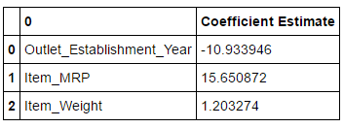
Linear regression with 3 Variables
We learnt, by using two variables rather than one, we improved the ability to make accurate predictions about the item sales.
So, let us introduce another feature ‘weight’ in case 3. Now let’s build a regression model with these three features.
X = train.loc[:,['Outlet_Establishment_Year','Item_MRP','Item_Weight’]]
## splitting into training and cv for cross validation
x_train, x_cv, y_train, y_cv = train_test_split(X,train.Item_Outlet_Sales)
## training the model lreg.fit(x_train,y_train)
predicting on cv pred = lreg.predict(x_cv)
calculating mse
mse = np.mean((pred - y_cv)**2)
mse
1853431.59
## calculating coefficients
coeff = DataFrame(x_train.columns)
coeff['Coefficient Estimate'] = Series(lreg.coef_)
calculating r-square
lreg.score(x_cv,y_cv) 0.32942
Therefore we can see that the mse is further reduced. There is an increase in the value R-square, does it mean that the addition of item weight is useful for our model?

Slide 11

Adjusted R-Square
Adjusted R-square
The only drawback of R2 is that if new predictors (X) are added to our model, R2 only increases or remains constant but it never decreases. We can not judge that by increasing complexity of our model, are we making it more accurate?
That is why, we use “Adjusted R-Square”.
The Adjusted R-Square is the modified form of R-Square that has been adjusted for the number of predictors in the model. It incorporates model’s degree of freedom. The adjusted R-Square only increases if the new term improves the model accuracy.
R2 = Sample R square
p = Number of predictors
N = total sample size

Slide 12
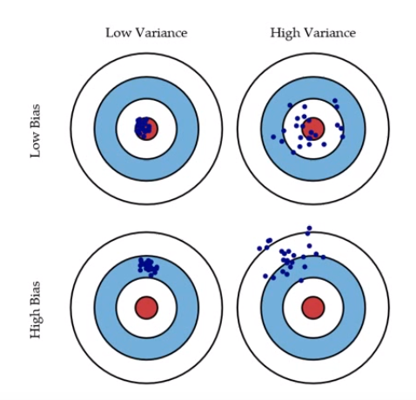
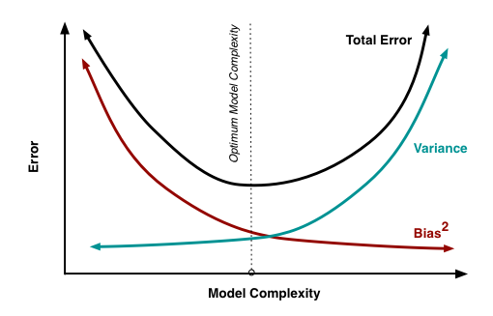
Bias & Variance in Regression Models
What does that bias and variance actually mean? Let us understand this by an example of archery targets.
Let’s say we have model which is very accurate, therefore the error of our model will be low, meaning a low bias and low variance as shown in first figure. All the data points fit within the bulls-eye. Similarly we can say that if the variance increases, the spread of our data point increases which results in less accurate prediction. And as the bias increases the error between our predicted value and the observed values increases.
Now how this bias and variance is balanced to have a perfect model? Take a look at the image below and try to understand.
As we add more and more parameters to our model, its complexity increases, which results in increasing variance and decreasing bias, i.e., overfitting.
So we need to find out one optimum point in our model where the decrease in bias is equal to increase in variance. In practice, there is no analytical way to find this point. So how to deal with high variance or high bias?
To overcome underfitting or high bias, we can basically add new parameters to our model so that the model complexity increases, and thus reducing high bias.
Now, how can we overcome Overfitting for a regression model?
Basically, there are two methods to overcome overfitting,
a) Reduce the model complexity
b) Regularization

Slide 13
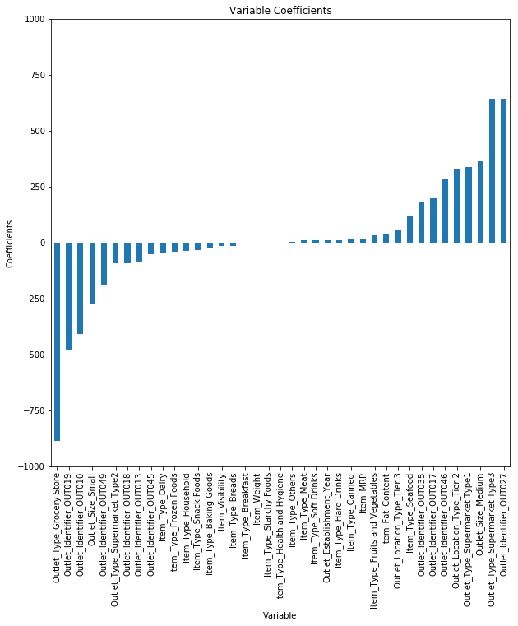
Regularization
In regularization, what we do is normally we keep the same number of features but reduce the magnitude of the coefficients . How does reducing the coefficients will help us?
Let us take a look at the coefficients of feature in our above regression model.
checking the magnitude of coefficients
predictors = x_train.columns
coef = Series(lreg.coef_,predictors).sort_values()
coef.plot(kind='bar', title='Modal Coefficients')
We can see that coefficients of Outlet_Identifier_OUT027 and Outlet_Type_Supermarket_Type3(last 2) is much higher as compared to rest of the coefficients. Therefore the total sales of an item would be more driven by these two features.
How can we reduce the magnitude of coefficients in our model?
For this purpose, we have different types of regression techniques which uses regularization to overcome this problem. So let us discuss them.

Slide 14

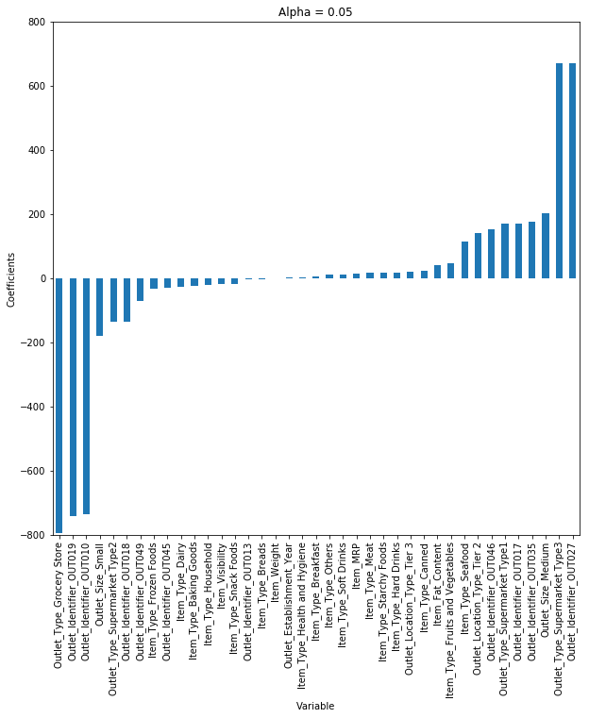
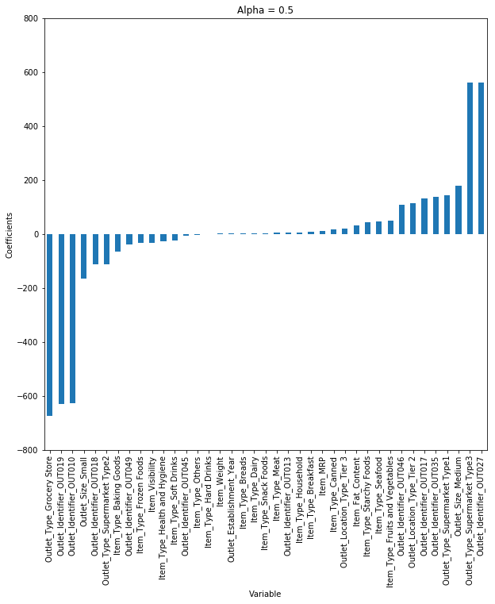
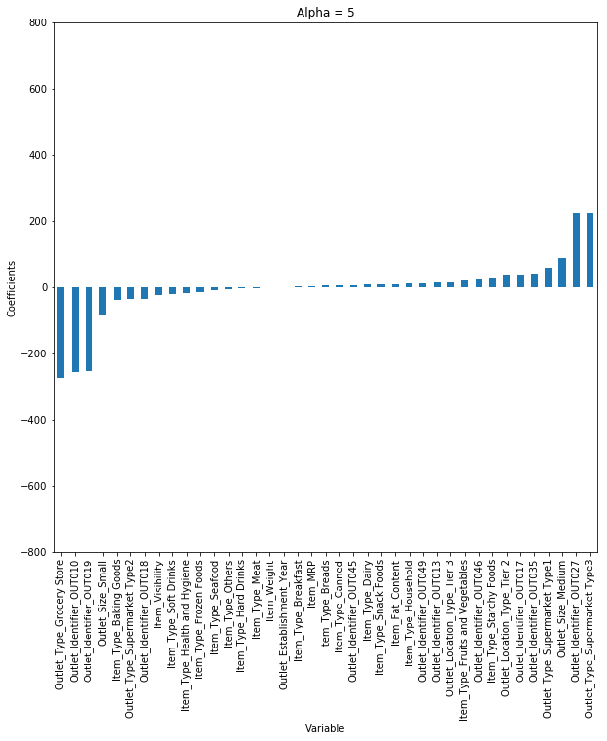
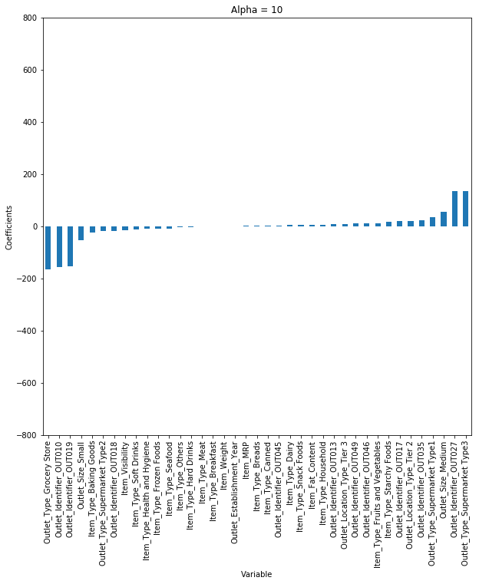
Ridge regression
Let us first implement it on our above problem and check our results that whether it performs better than our linear regression model.
from sklearn.linear_model import Ridge
## training the model
ridgeReg = Ridge(alpha=0.05, normalize=True)
ridgeReg.fit(x_train,y_train)
pred = ridgeReg.predict(x_cv)
calculating mse
mse = np.mean((pred_cv - y_cv)**2)
mse 1348171.96 ## calculating score ridgeReg.score(x_cv,y_cv) 0.5691
So, we can see that there is a slight improvement in our model because the value of the R-Square has been increased. Note that value of alpha, which is hyperparameter of Ridge,
which means that they are not automatically learned by the model instead they have to be set manually.
Here we have considered alpha = 0.05. But let us consider different values of alpha and plot the coefficients for each case. (below diagram for different values for alpha)
As we increase the value of alpha, the coefficients shrink towards 0 but does not reach absolute 0. If you calculate R-square for each alpha, we will see that it will be max for alpha = 0.05. So, we have to chose it wisely by choosing the one that gives the lowest error
Above is the cost function for Ridge Regression.
It shrinks the parameters, therefore it is mostly used to prevent multicollinearity.
It reduces the model complexity by coefficient shrinkage.
It uses L2 regularization technique.

Slide 15
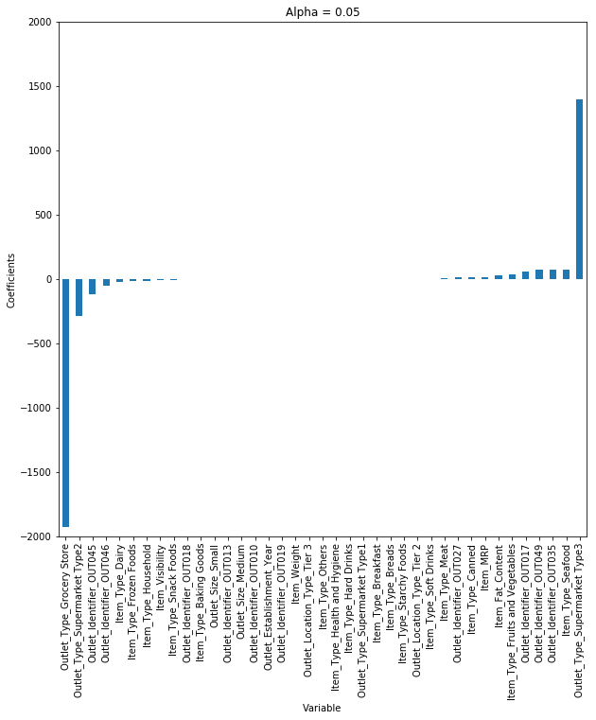
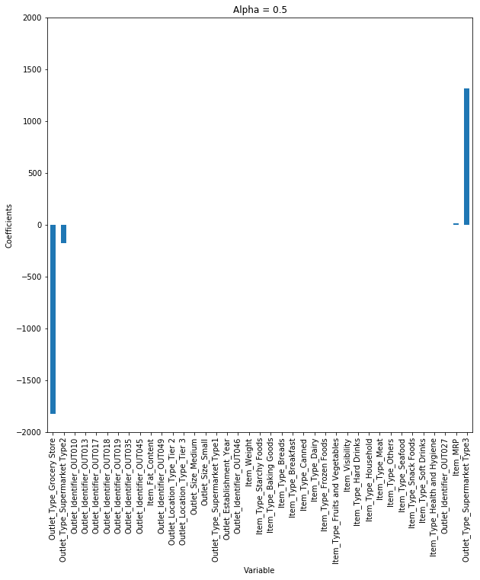

Lasso regression
LASSO (Least Absolute Shrinkage Selector Operator), is quite similar to ridge, but let’s understand the difference them by implementing it in the same model.
from sklearn.linear_model import Lasso
lassoReg = Lasso(alpha=0.3, normalize=True)
lassoReg.fit(x_train,y_train)
pred = lassoReg.predict(x_cv)
# calculating mse
mse = np.mean((pred_cv - y_cv)**2)
mse
1346205.82
lassoReg.score(x_cv,y_cv)
0.5720
As we can see that, both the mse and the value of R-square for our model has been increased. Therefore, lasso model is predicting better than both linear and ridge.
Again lets change the value of alpha and see how does it affect the coefficients.
So, we can see that even at small values of alpha, the magnitude of coefficients have reduced a lot. Mathematics behind lasso regression is quiet similar to that of ridge only difference being instead of adding squares of theta, we will add absolute value of Θ.
Here too, λ is the hypermeter, whose value is equal to the alpha in the Lasso function
We can see that as we increased the value of alpha, coefficients were approaching towards zero, but if you see in case of lasso, even at smaller alpha’s, our coefficients are reducing to absolute zeroes. Therefore, lasso selects the only some feature while reduces the coefficients of others to zero. This property is known as feature selection and which is absent in case of ridge.
It uses L1 regularization technique
It is generally used when we have more number of features, because it automatically does feature selection.

Slide 16
Elastic Net regression
let’s think of an example where we have a large dataset, lets say it has 10,000 features. And we know that some of the independent features are correlated with other independent features. Then think, which regression would you use, Rigde or Lasso?
Let’s discuss it one by one. If we apply ridge regression to it, it will retain all of the features but will shrink the coefficients. But the problem is that model will still remain complex as there are 10,000 features, thus may lead to poor model performance.
Instead of ridge what if we apply lasso regression to this problem. The main problem with lasso regression is when we have correlated variables, it retains only one variable and sets other correlated variables to zero. That will possibly lead to some loss of information resulting in lower accuracy in our model.
This is where elastic net regression , which is basically a hybrid of ridge and lasso regression comes useful.
Let’s implement it to our data set and check the performance.
from sklearn.linear_model import ElasticNet
ENreg = ElasticNet(alpha=1, l1_ratio=0.5, normalize=False)
ENreg.fit(x_train,y_train)
pred_cv = ENreg.predict(x_cv)
#calculating mse
mse = np.mean((pred_cv - y_cv)**2)
mse 1773750.73
ENreg.score(x_cv,y_cv)
0.4504
So we get the value of R-Square, which is very less than both ridge and lasso. The reason behind this downfall is basically we didn’t have a large set of features. Elastic regression generally works well when we have a big dataset.
It’s a combination of L1 and L2 Regularization. So, if we know Elastic net, we can implement both Ridge & Lasso by tuning the parameters.

